Slide 1

Press kit
Imidjeologia
A musical collaboration
between a human creator and AI
A creator-led music project
in Russian
Notes:
Public project material. Narrative scenes describe the songs and do not state the creator’s biography. The vocals are synthetic. The creator stays out of the public spotlight. The release date has not been announced. Song titles shown in English are translations for navigation. Original Russian release titles remain unchanged.

Slide 2
How the music takes shape
Creative foundation
Personal experience, poetry and musical influences
set the project's direction.
Language model
Helps develop lyrics and describe
the intended musical style.
Music system
A generative system creates music
and synthetic vocal parts.
Artistic choices
The creator develops the idea, selects versions
and decides how to release the work.
02
Notes:
Public project material. Narrative scenes describe the songs and do not state the creator’s biography. The vocals are synthetic. The creator stays out of the public spotlight. The release date has not been announced. Song titles shown in English are translations for navigation. Original Russian release titles remain unchanged.

Slide 3
Debut: Pass It On (Передавай)
6
Six songs about moments
you want to keep going
A meeting changes the evening.
A shared table brings people closer.
A first attempt becomes a reason to try again.
The debut album is in preparation.
The release date will be announced separately.
The images on the following pages belong to individual songs. The album cover is still being chosen.
03
Notes:
Public project material. Narrative scenes describe the songs and do not state the creator’s biography. The vocals are synthetic. The creator stays out of the public spotlight. The release date has not been announced. Song titles shown in English are translations for navigation. Original Russian release titles remain unchanged.

Slide 4
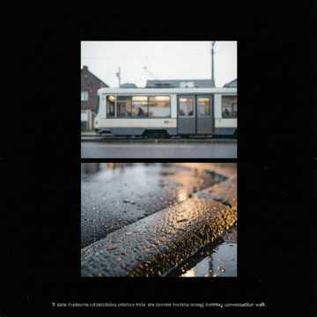
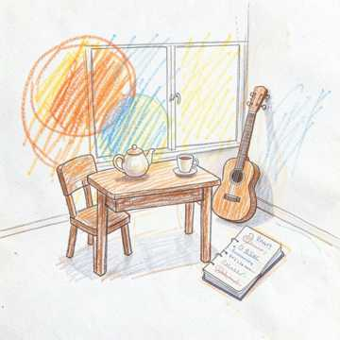
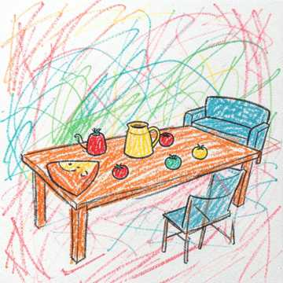
Album songs
01
02
03
One More Block
Leave It As It Is
Pass It On
A walk that both people
choose to extend.
The first take holds
their shared laughter.
A shared table begins
with a simple invitation.
04
Notes:
Public project material. Narrative scenes describe the songs and do not state the creator’s biography. The vocals are synthetic. The creator stays out of the public spotlight. The release date has not been announced. Song titles shown in English are translations for navigation. Original Russian release titles remain unchanged.

Slide 5
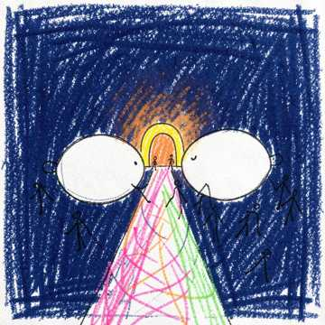
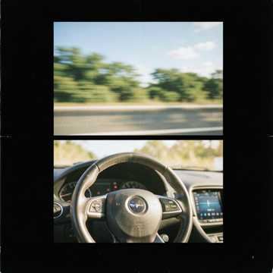
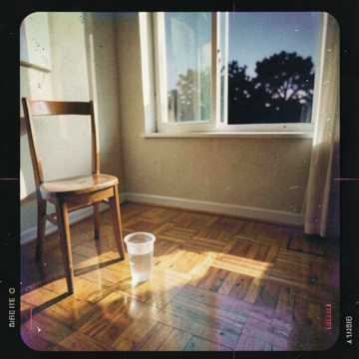
Album songs. Continued
04
05
06
Closer
Windows Down,
Music Up
It Worked
A conversation becomes
a reason to come closer.
Small details make the trip
to the lake memorable.
A first step into a dance
you want to repeat.
05
Notes:
Public project material. Narrative scenes describe the songs and do not state the creator’s biography. The vocals are synthetic. The creator stays out of the public spotlight. The release date has not been announced. Song titles shown in English are translations for navigation. Original Russian release titles remain unchanged.

Slide 6
Contact Imidjeologia
Imidjeologia brings the creator's experience
and original poetry together with the possibilities of AI.
A language model helps shape words and style briefs.
A generative music system creates the music
and synthetic vocals. The creator determines
the artistic direction.
For editors, radio, producers and partners.
Tell us the format, outlet and timing.
Contact: hello@imidjeologia.com
06
Notes:
Public project material. Narrative scenes describe the songs and do not state the creator’s biography. The vocals are synthetic. The creator stays out of the public spotlight. The release date has not been announced. Song titles shown in English are translations for navigation. Original Russian release titles remain unchanged.

